Slide 1
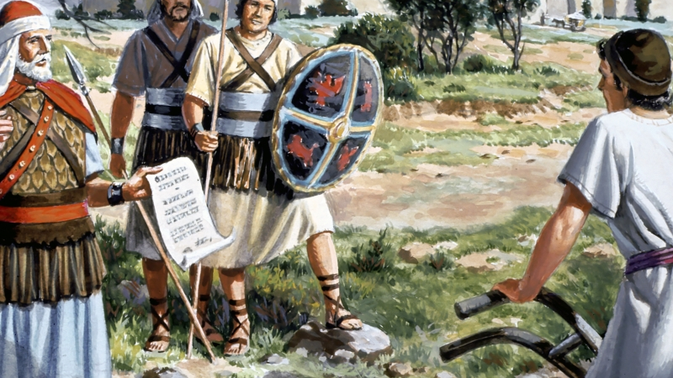
1 Samuel 11
Victory Over
the Serpent

Slide 2
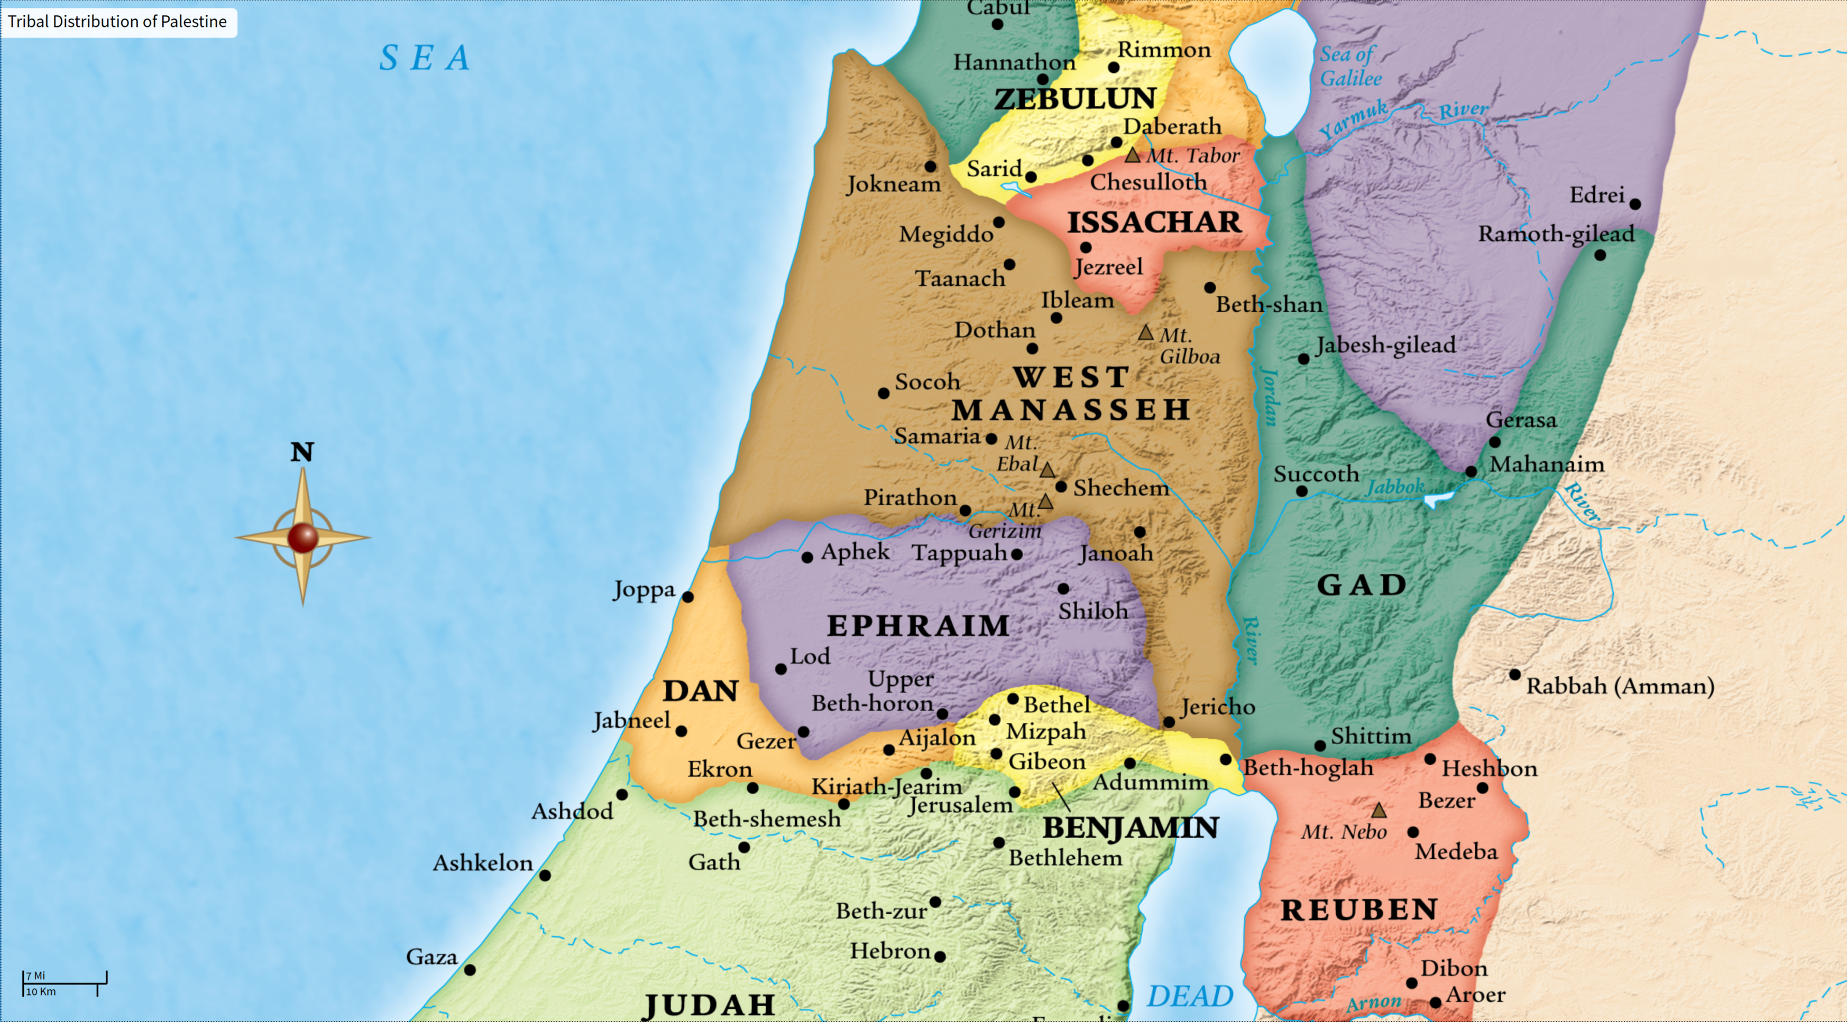
The Demand.
The Serpent Attacks
Ammon – the inbred
nation from Lot.

Slide 3

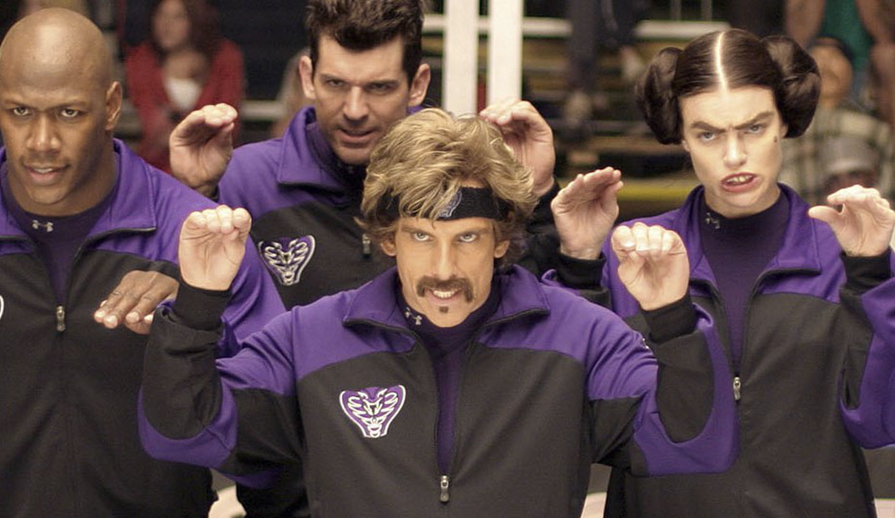
Nahash = “serpent”
The danger: God’s
people give in and
give up in the
spiritual battle.
Result: damage
and reproach.
Revelation 12:9 And the great dragon was cast out, that old serpent, called the Devil, and Satan, which deceiveth the whole world: he was cast out into the earth, and his angels were cast out with him.

Slide 4
When we yield to sin, it messes up our eyesight.
2 Corinthians 4:3-4 But if our gospel be hid, it is hid to them that are lost: 4 In whom the god of this world hath blinded the minds of them which believe not, lest the light of the glorious gospel of Christ, who is the image of God, should shine unto them.

Slide 5
We need our eyes OPEN!
Ephesians 1:18 The eyes of your understanding being enlightened; that ye may know what is the hope of his calling, and what the riches of the glory of his inheritance in the saints

Slide 6
The Desperation. The Plea for Help.
The snake goes for it. He wants them to to give up without a fight. That’s more profitable for him.
He thought that Israel wasn’t unified, so its a small risk.
Picture: If there is no one to save you – the devil owns you!
James 5:16 Confess your faults one to another, and pray one for another, that ye may be healed. The effectual fervent prayer of a righteous man availeth much.

Slide 7
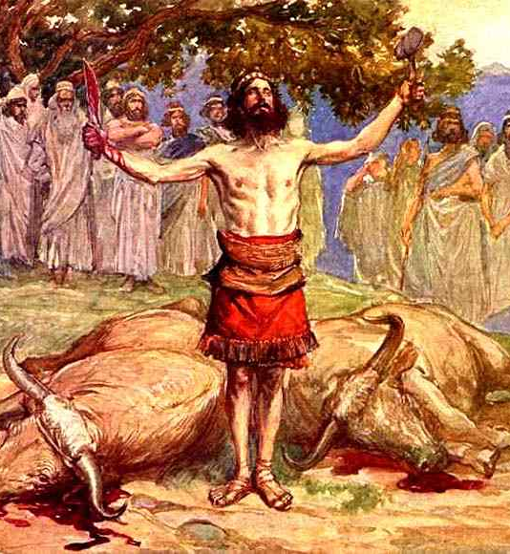
The Decree.
Saul Demands a Unified Response
REMEMBER! Saul has family
from Jabesh-Giliad.
Saul knows the story of the
Levite from Judges 19.
Saul called a mandatory meeting.

Slide 8
Ephesians 6:4 And, ye fathers, provoke not your children to wrath: but bring them up in the nurture and admonition of the Lord.

Slide 9
The Decree.
Saul Demands a Unified Response
REMEMBER!
Saul has family from there.
Saul knows the story of the
Levite from Judges 19.
Saul called a mandatory meeting.
Why is Saul being so harsh?

Slide 10
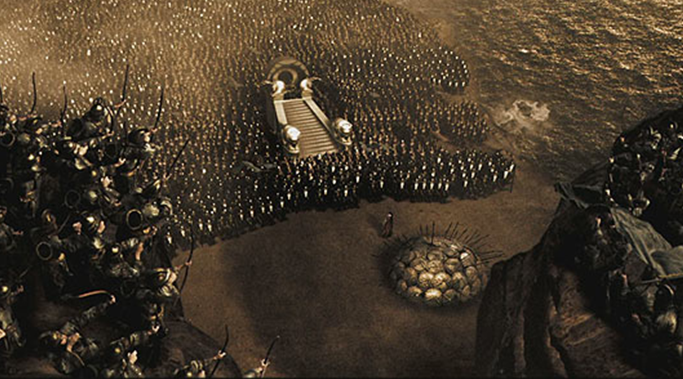
There is great power in unity.

Slide 11
The Deliverance. The Counter Attack.
They followed proven tactics (Judges 7:16-19)
A 3-sided attack.
Just as coming together in unity is a powerful force for victory, a divided people is a broken people. Defeated!
Mark 3:24-25 And if a kingdom be divided against itself, that kingdom cannot stand. And if a house be divided against itself, that house cannot stand.

Slide 12
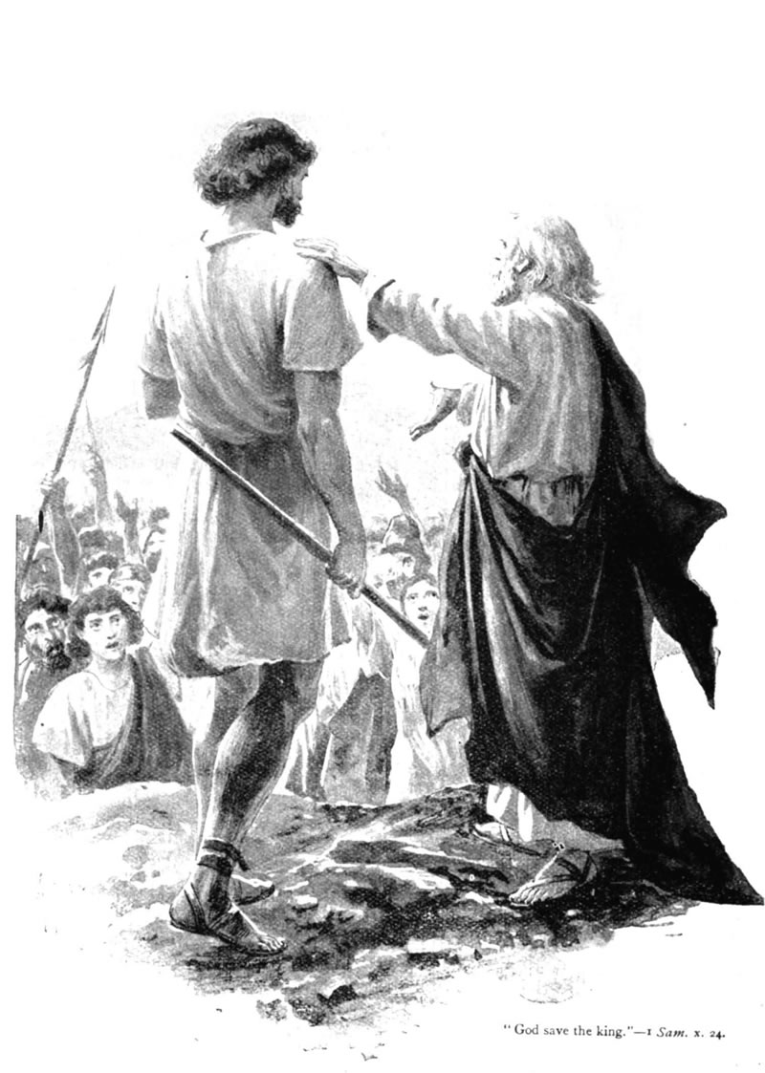
The Confirmation.
Nothing builds support like success.
Doing what’s right should build support.
2 Corinthians 10:17 But he that glorieth,
let him glory in the Lord.
Saul sought no personal revenge on those
who initially rebelled against him. (10:27)

Slide 13
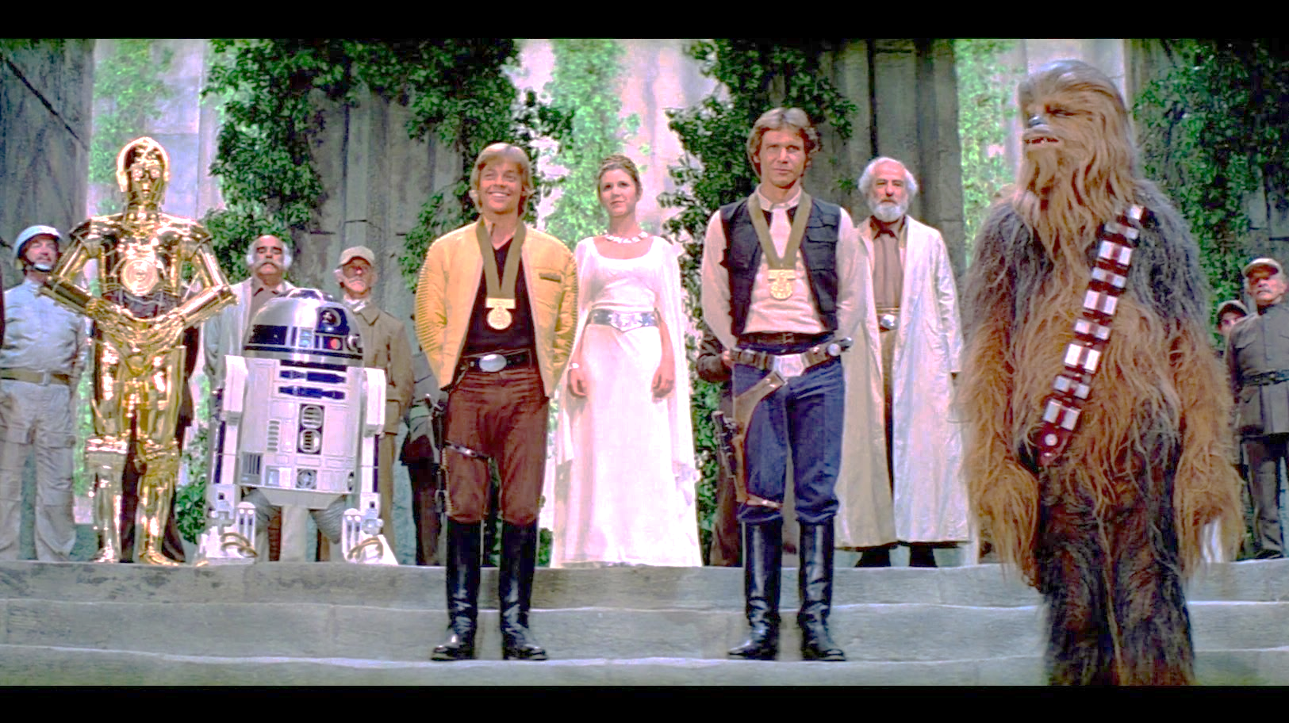
Notes:
Saul blessing samuel

Slide 14
The Confirmation.
God also gave him favor in the eyes of
His people. (vs 12-15)
Proverbs 16:7 When a man's ways
please the LORD, he maketh even
his enemies to be at peace with him.
When it’s going good, we can lose
our recognition of dependence on God!
Self-sufficiency is deadly to true spirituality.

